Slide 1
Queues
Presented by s.r.zameer

Slide 2

Queues
Queue is an abstract data structure, somewhat similar to Stacks. In contrast to Queue, queue is opened at both end. One end is always used to insert data (en queue) and the other is used to remove data (de queue). Queue follows First-In-First-Out methodology, i.e., the data item stored first will be accessed first.

Slide 3
Basic Operations
Queue operations may involve initializing or defining the queue, utilizing it and then completing erasing it from memory.
enqueue() − add (store) an item to the queue.
dequeue() − remove (access) an item from the queue.
peek() − get the element at front of the queue without removing it.
isfull() − checks if queue is full.
isempty() − checks if queue is empty.
In queue, we always dequeue (or access) data, pointed by front pointer and while enqueing (or storing) data in queue we take help of rear pointer.

Slide 4
Enqueue Operation
As queue maintains two data pointers, front and rear, its operations are comparatively more difficult to implement than Queue.
Algorithm for enqueuing
Step 1 − Check if queue is full.
Step 2 − If queue is full, produce overflow error and exit.
Step 3 − If queue is not full, increment rear pointer to point next empty space.
Step 4 − Add data element to the queue location, where rear is pointing.
Step 5 − return success.

Slide 5
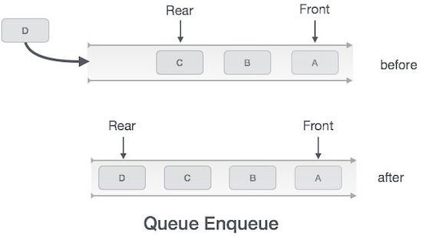

Slide 6
Dequeue Operation
Accessing data from queue is a process of two tasks − access the data where front is pointing and remove the data after access.
Algorithm for Dequeuing
Step 1 − Check if queue is empty.
Step 2 − If queue is empty, produce underflow error and exit.
Step 3 − If queue is not empty, access data where front is pointing.
Step 3 − Increment front pointer to point next available data element.
Step 5 − return success.

Slide 7
